Slide 1
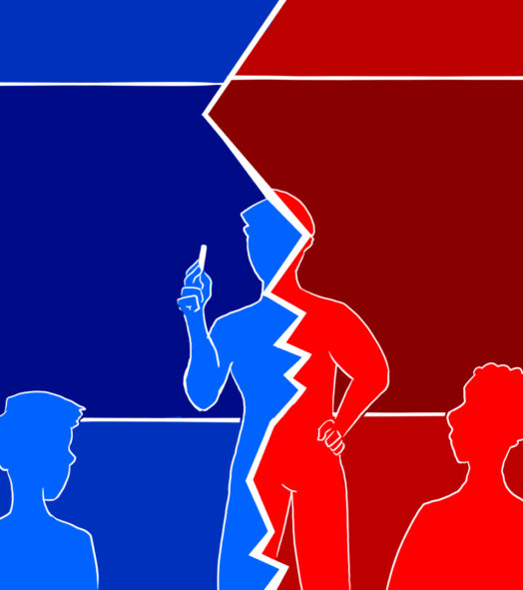
Opinion Polarization Conformity and Cross-group contact
Qi Zhang
Ziya Alim Sungkar
Ravi Sharma
He Liu

Slide 2

Social Impact of Opinion Polarization
Conformity pressure may drive societal polarization.
Balance social unity and diversity, reducing the risk of social division.

Slide 3
Research Questions and Reference
Purpose of the Study
How does herd behavior promote or inhibit the polarization of opinions?
How does interaction between opposite opinions affect the polarization?
Reference
Conformity pressure pushes each agent’s preference to the average preference at each moment in time. (Zusai, D. and Lu, F. , 2017)
One of the polarization mitigation strategies is to encourage cross-group contact (Allport, 1954).

Slide 4
Why ABM？
Simulating heterogeneity
Strategy testing
Micro-foundations of macro-phenomena
Dynamic processes
Complex interactions

Slide 5
Agent Design
Agents represent the inhabitants of a binary-opinionated society and can support opinion A or B.
An abstract value in the range [O𝑝 𝑎,O𝑝 𝑏]. Agent opinions change based on the opinion of their neighbors. Opinions are initially randomly distributed uniformly.
Agents interact in a network and on a grid.
0
5
10

Slide 6
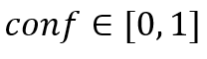
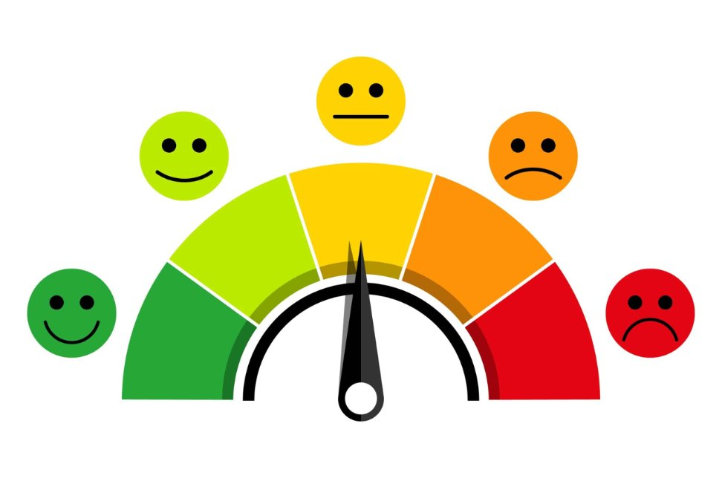
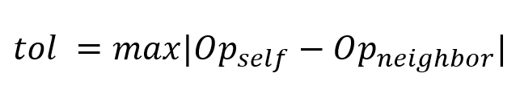
Model Assumptions：
Conformity
Conformity is the degree at which an agent will adjust their opinion based on that of their neighbors.
Tolerance
Tolerance to the degree of acceptance of differing opinion.
Assuming a highly intolerant society.

Slide 7
Forming and breaking relations
Over the course of the simulation, two agents with strongly differing opinions may break their relation.
The chance of breaking a relation goes up as the difference in opinion increases.
𝑝𝑏𝑟𝑒𝑎𝑘=|𝑜𝑝𝐴−𝑜𝑝𝐵|(1−𝑡𝑜𝑙𝐴)
Whenever an agent breaks a relationship, it will immediately form a new one at random.
Moving
Agents in neighborhood with differing opinion can move to a new empty location.

Slide 8
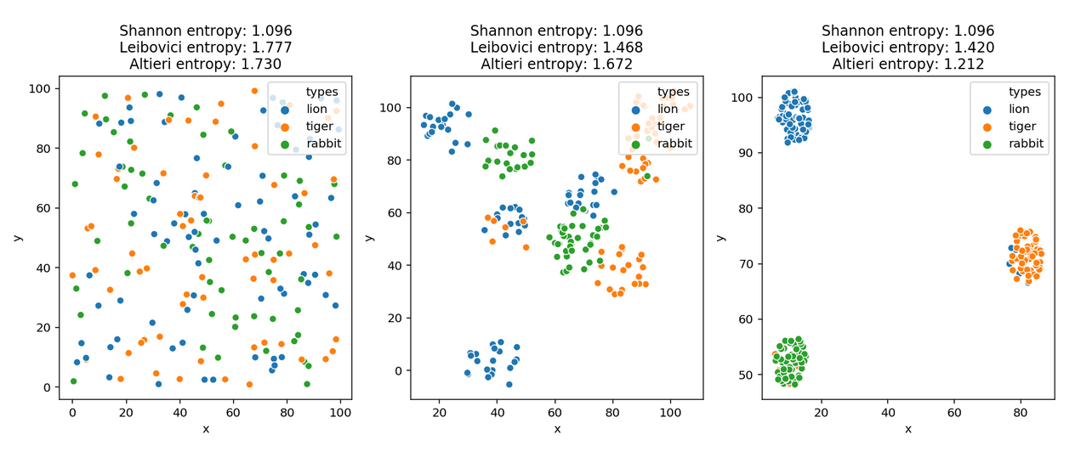
Measurement of polarization: Entropy

Slide 9
Model process - Flowchart
Break Bonds
Updated Agents
Agents
opinion is too different
Update Self Opinion
Makes New Bonds
Insufficient connections
Based on Average Neighbourhood Opinion and Conformity
Neighbours are of differing opinion
Moves to New Position

Slide 10
Experimental Process
Start
Initialize network
Initialize agents
Perform agent actions
Agent actions:
Make/ break connection
Move
Update opinion
Gauge polarization
Is step count < max ?
Is iterations < max ?
Stop

Slide 11
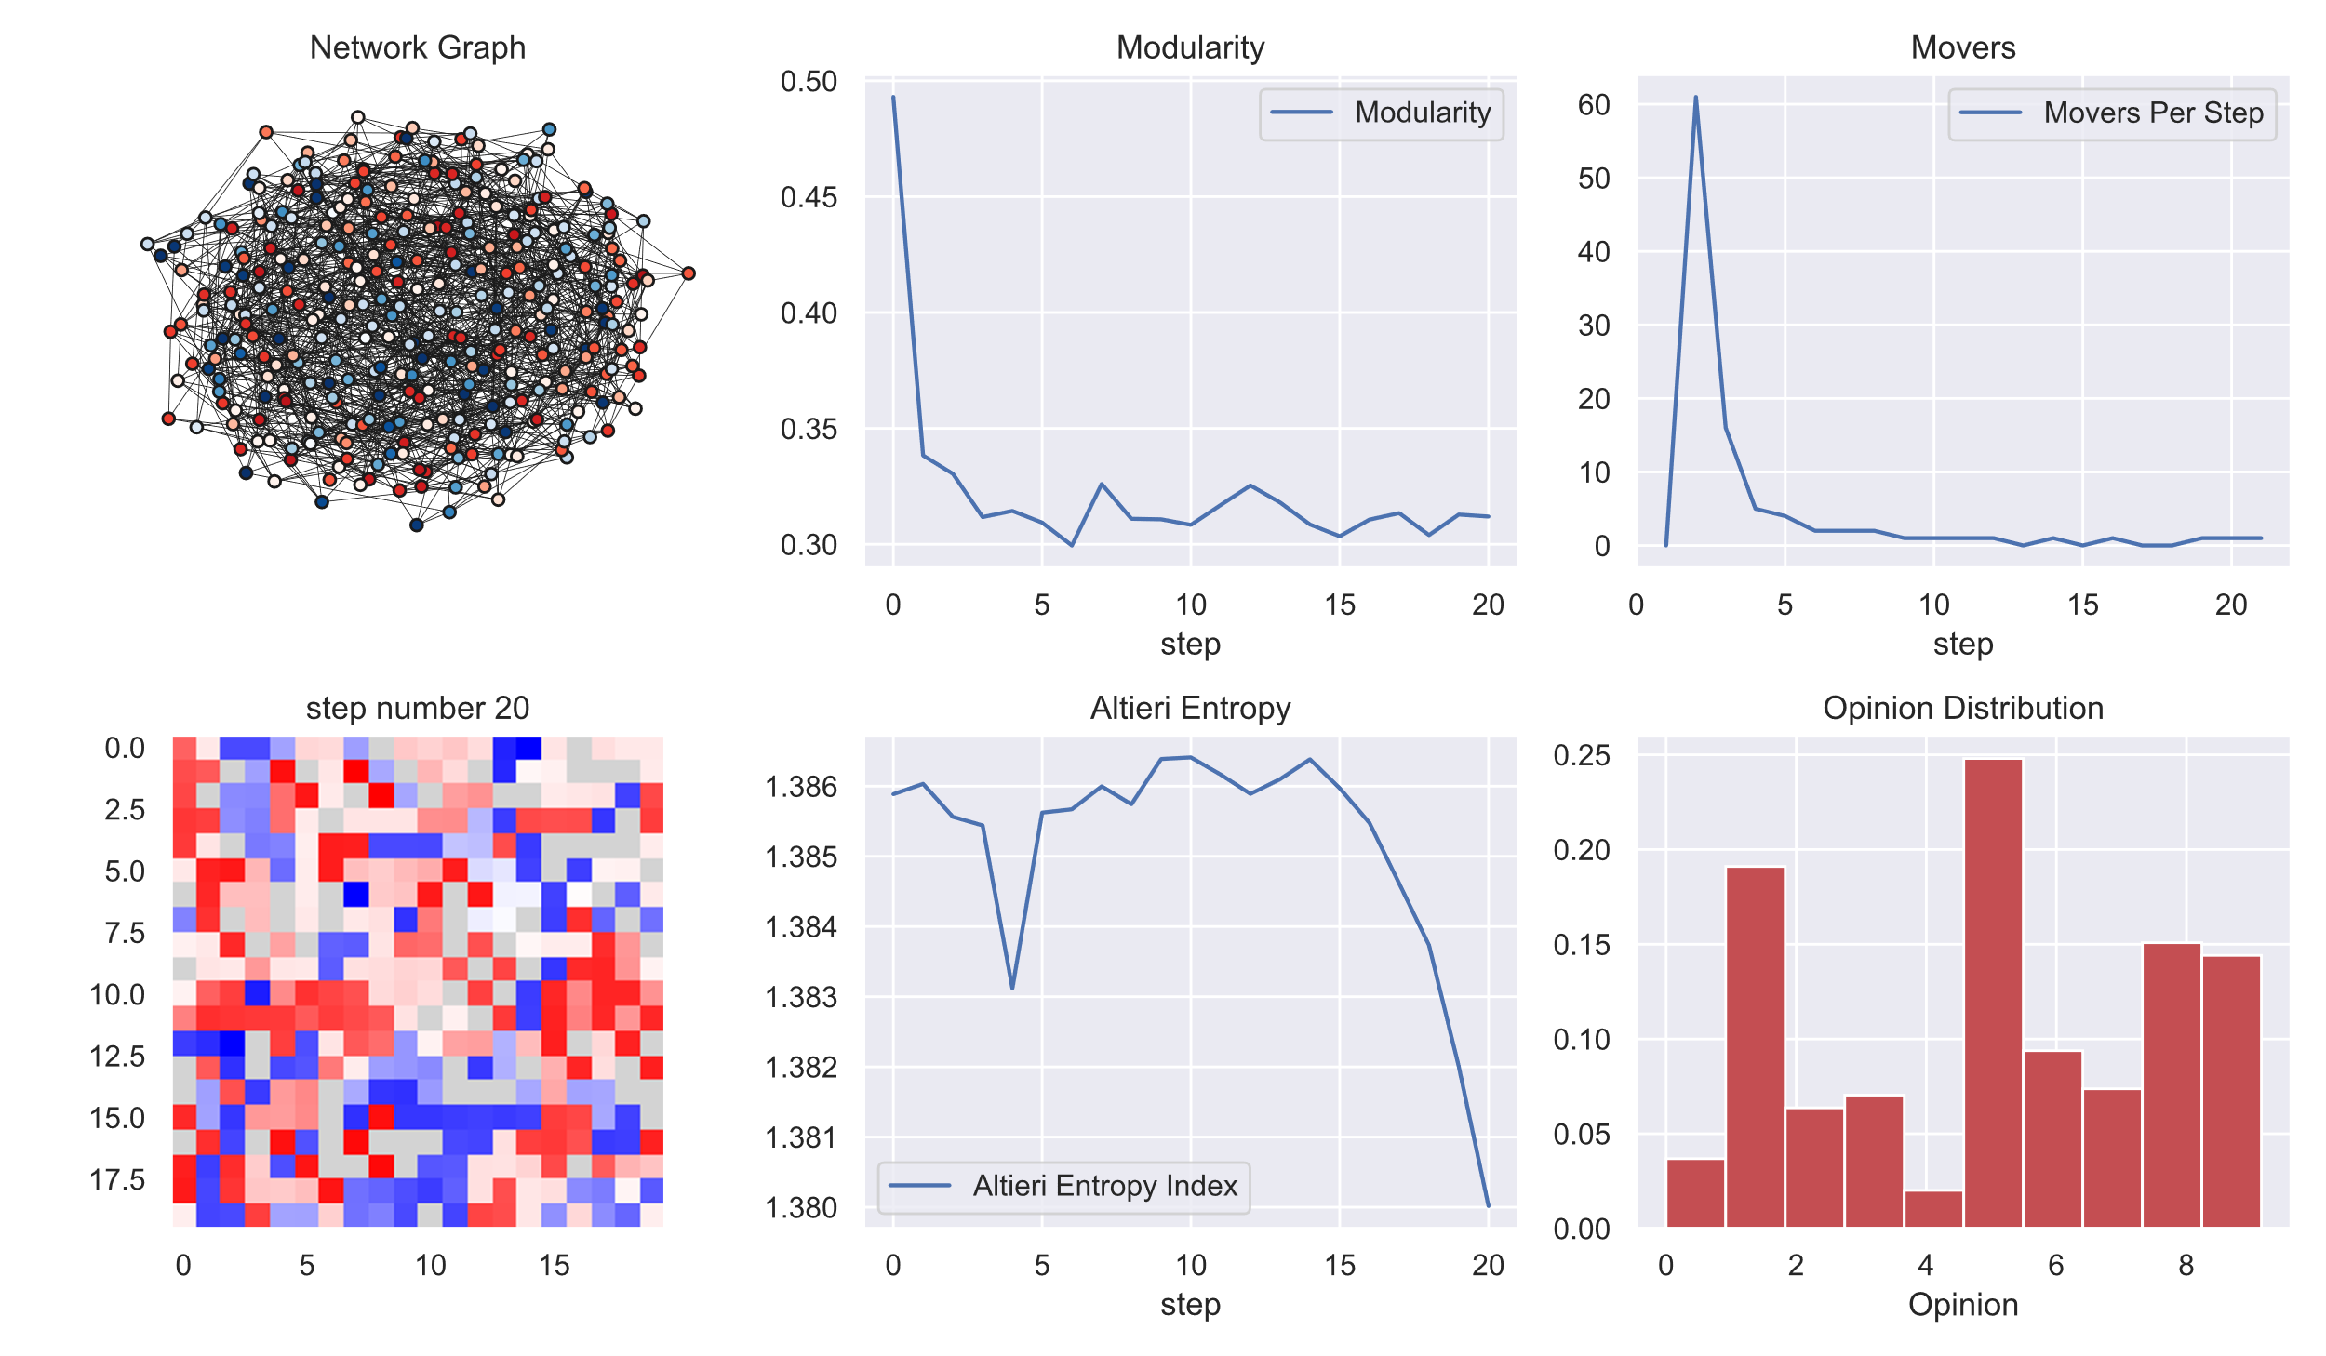
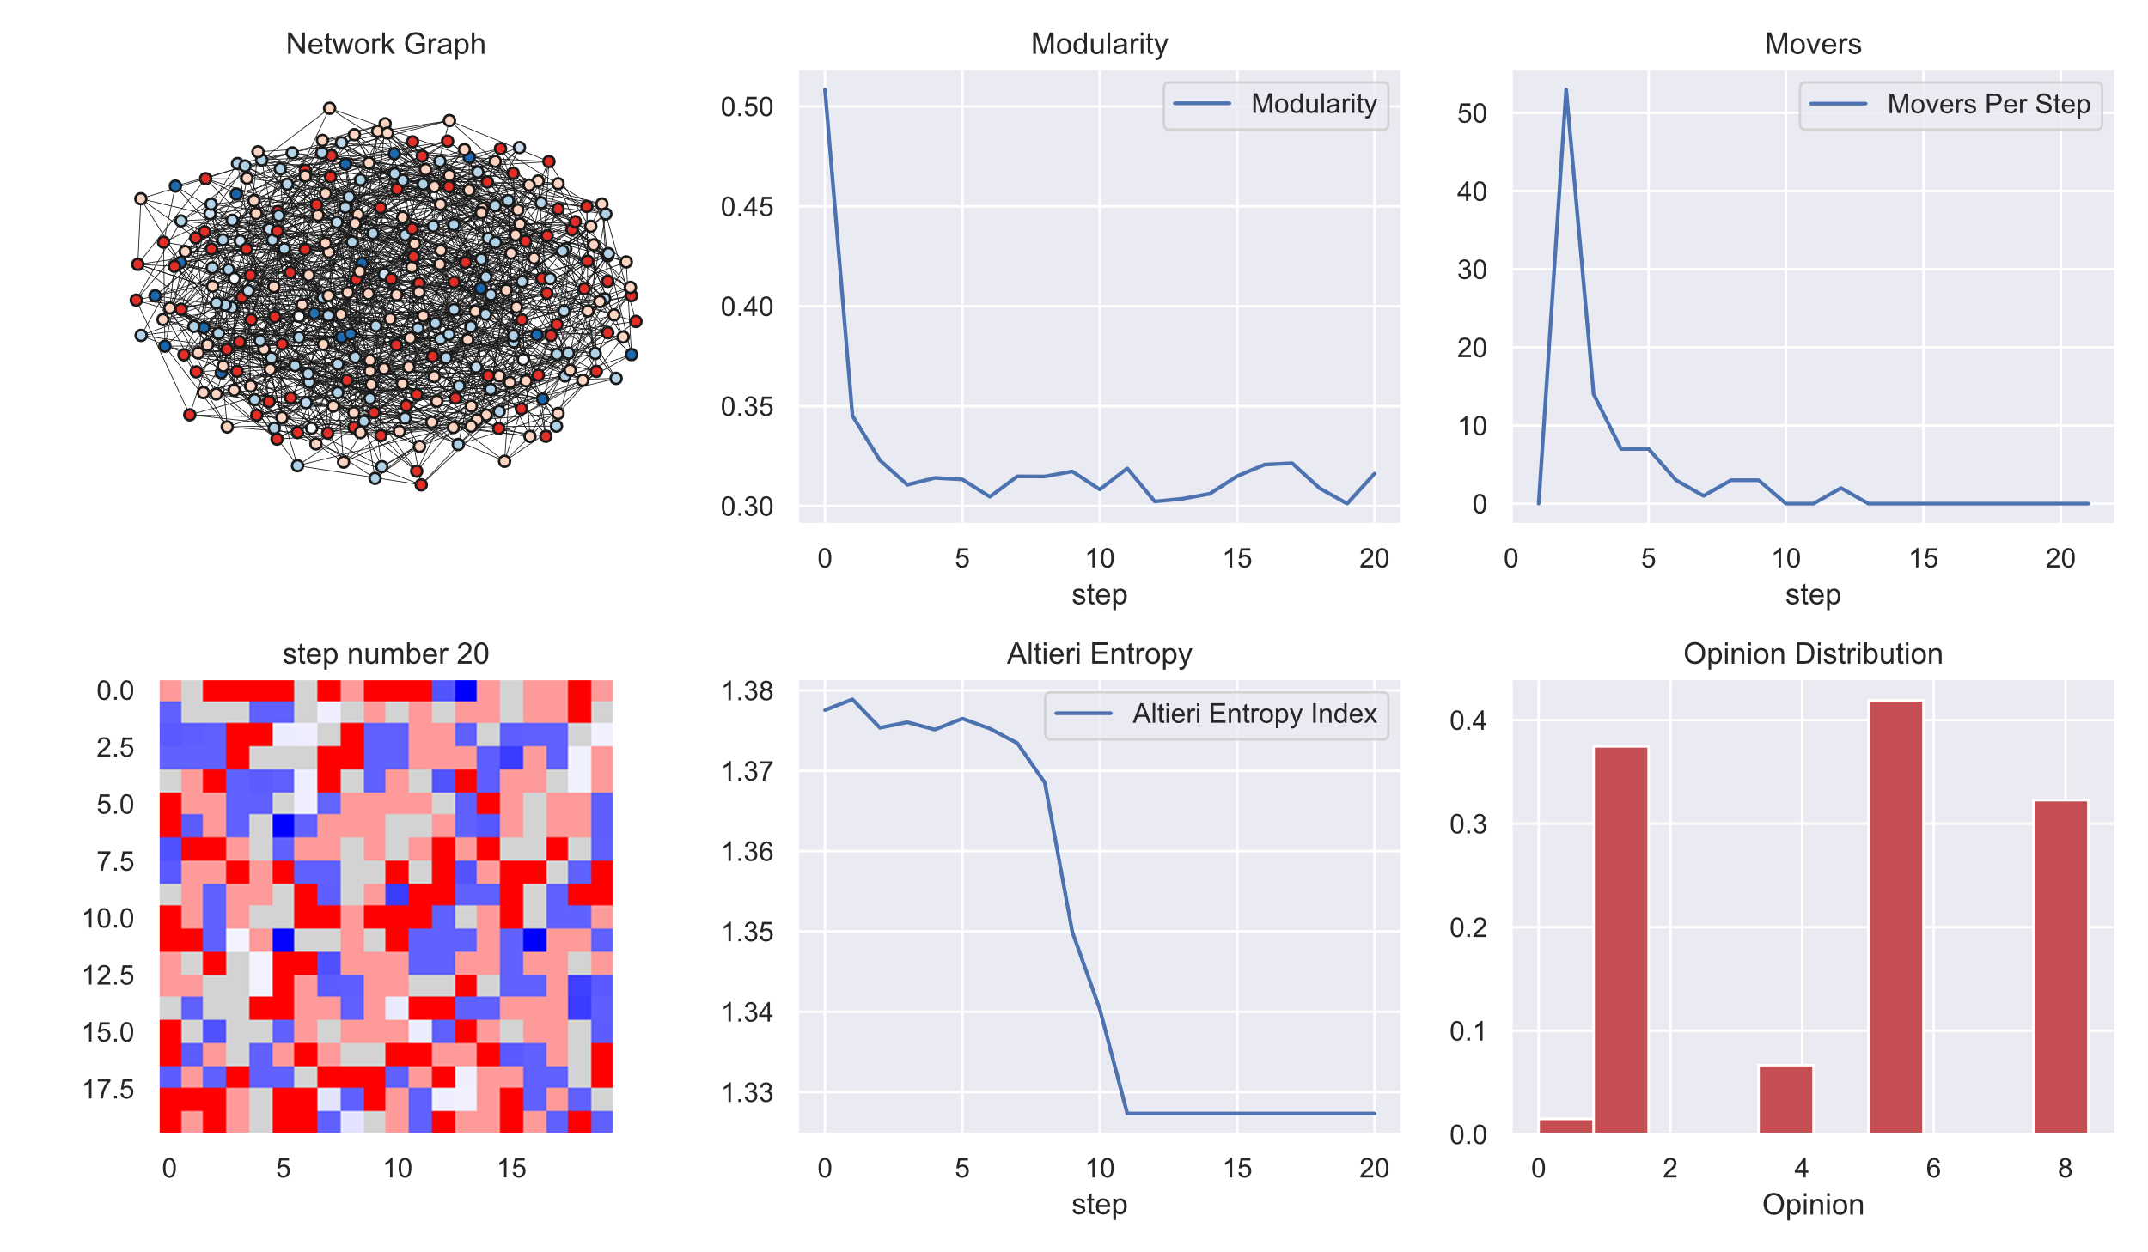
Results: Conformity causes polarization
Conformity=0.2
Conformity=0.8

Slide 12
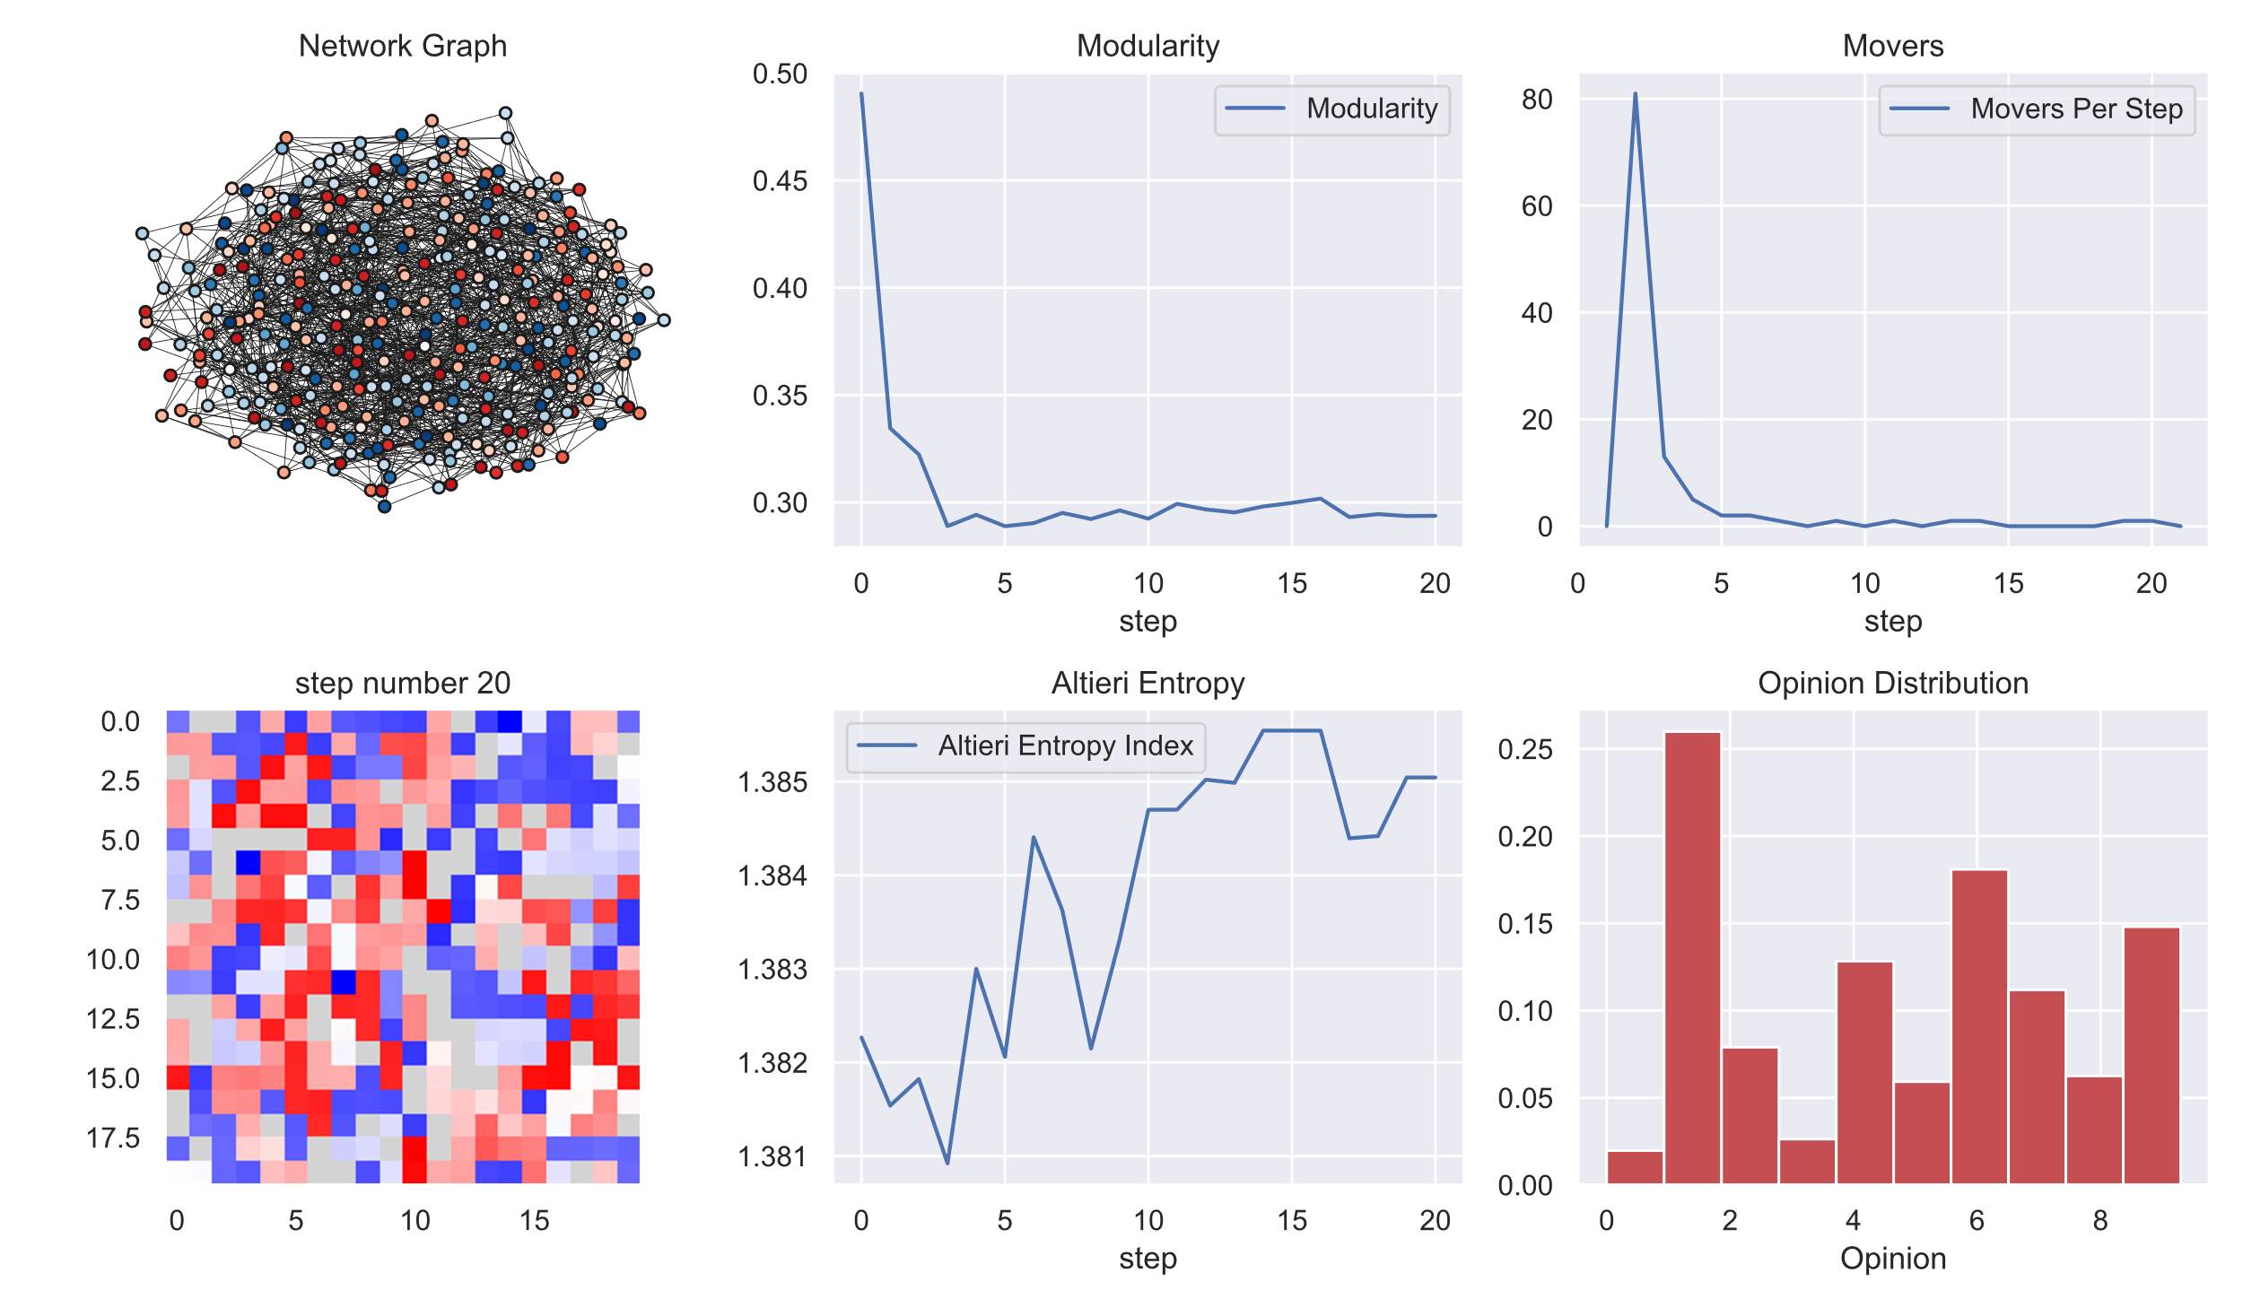
Experiment: Add cross-group contact
Conformity = 0.2
Without Cross Connection
With Cross Connection

Slide 13
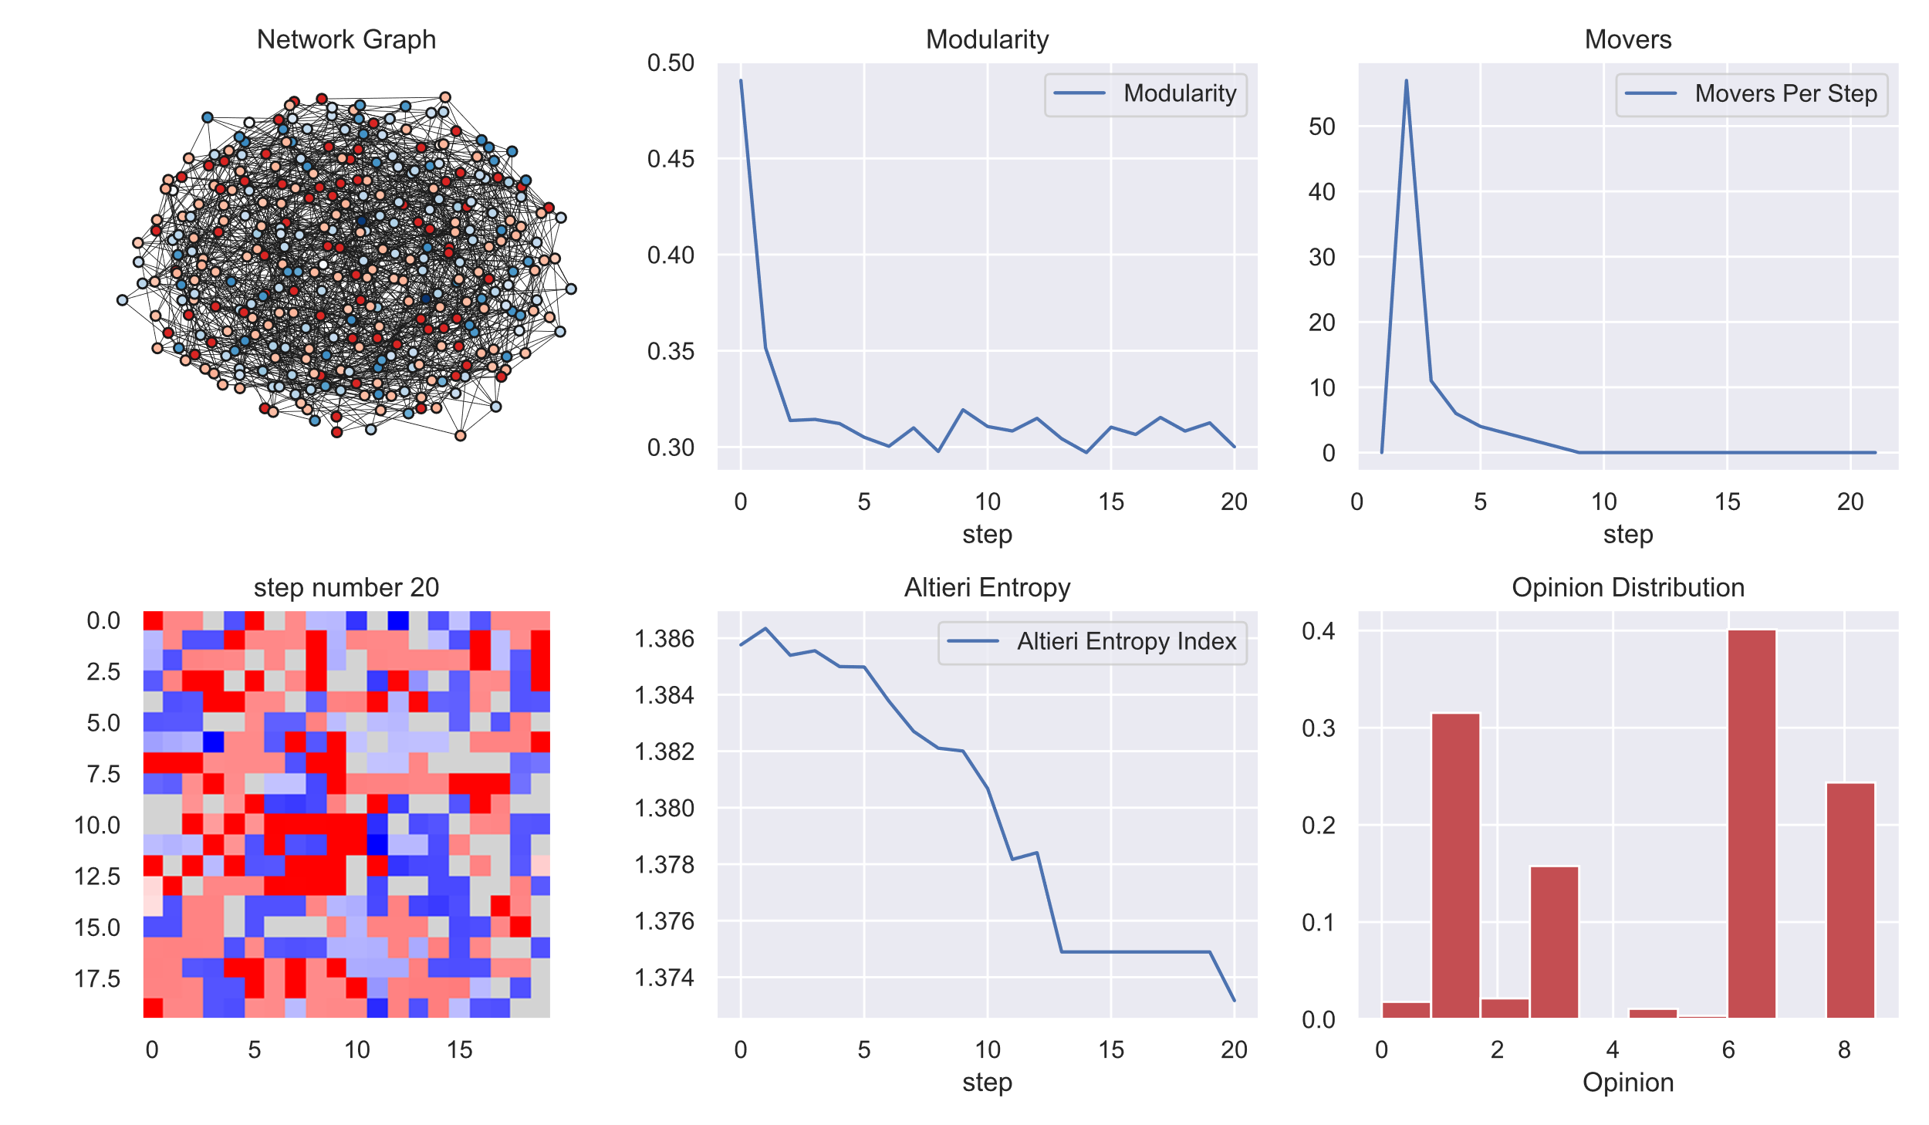
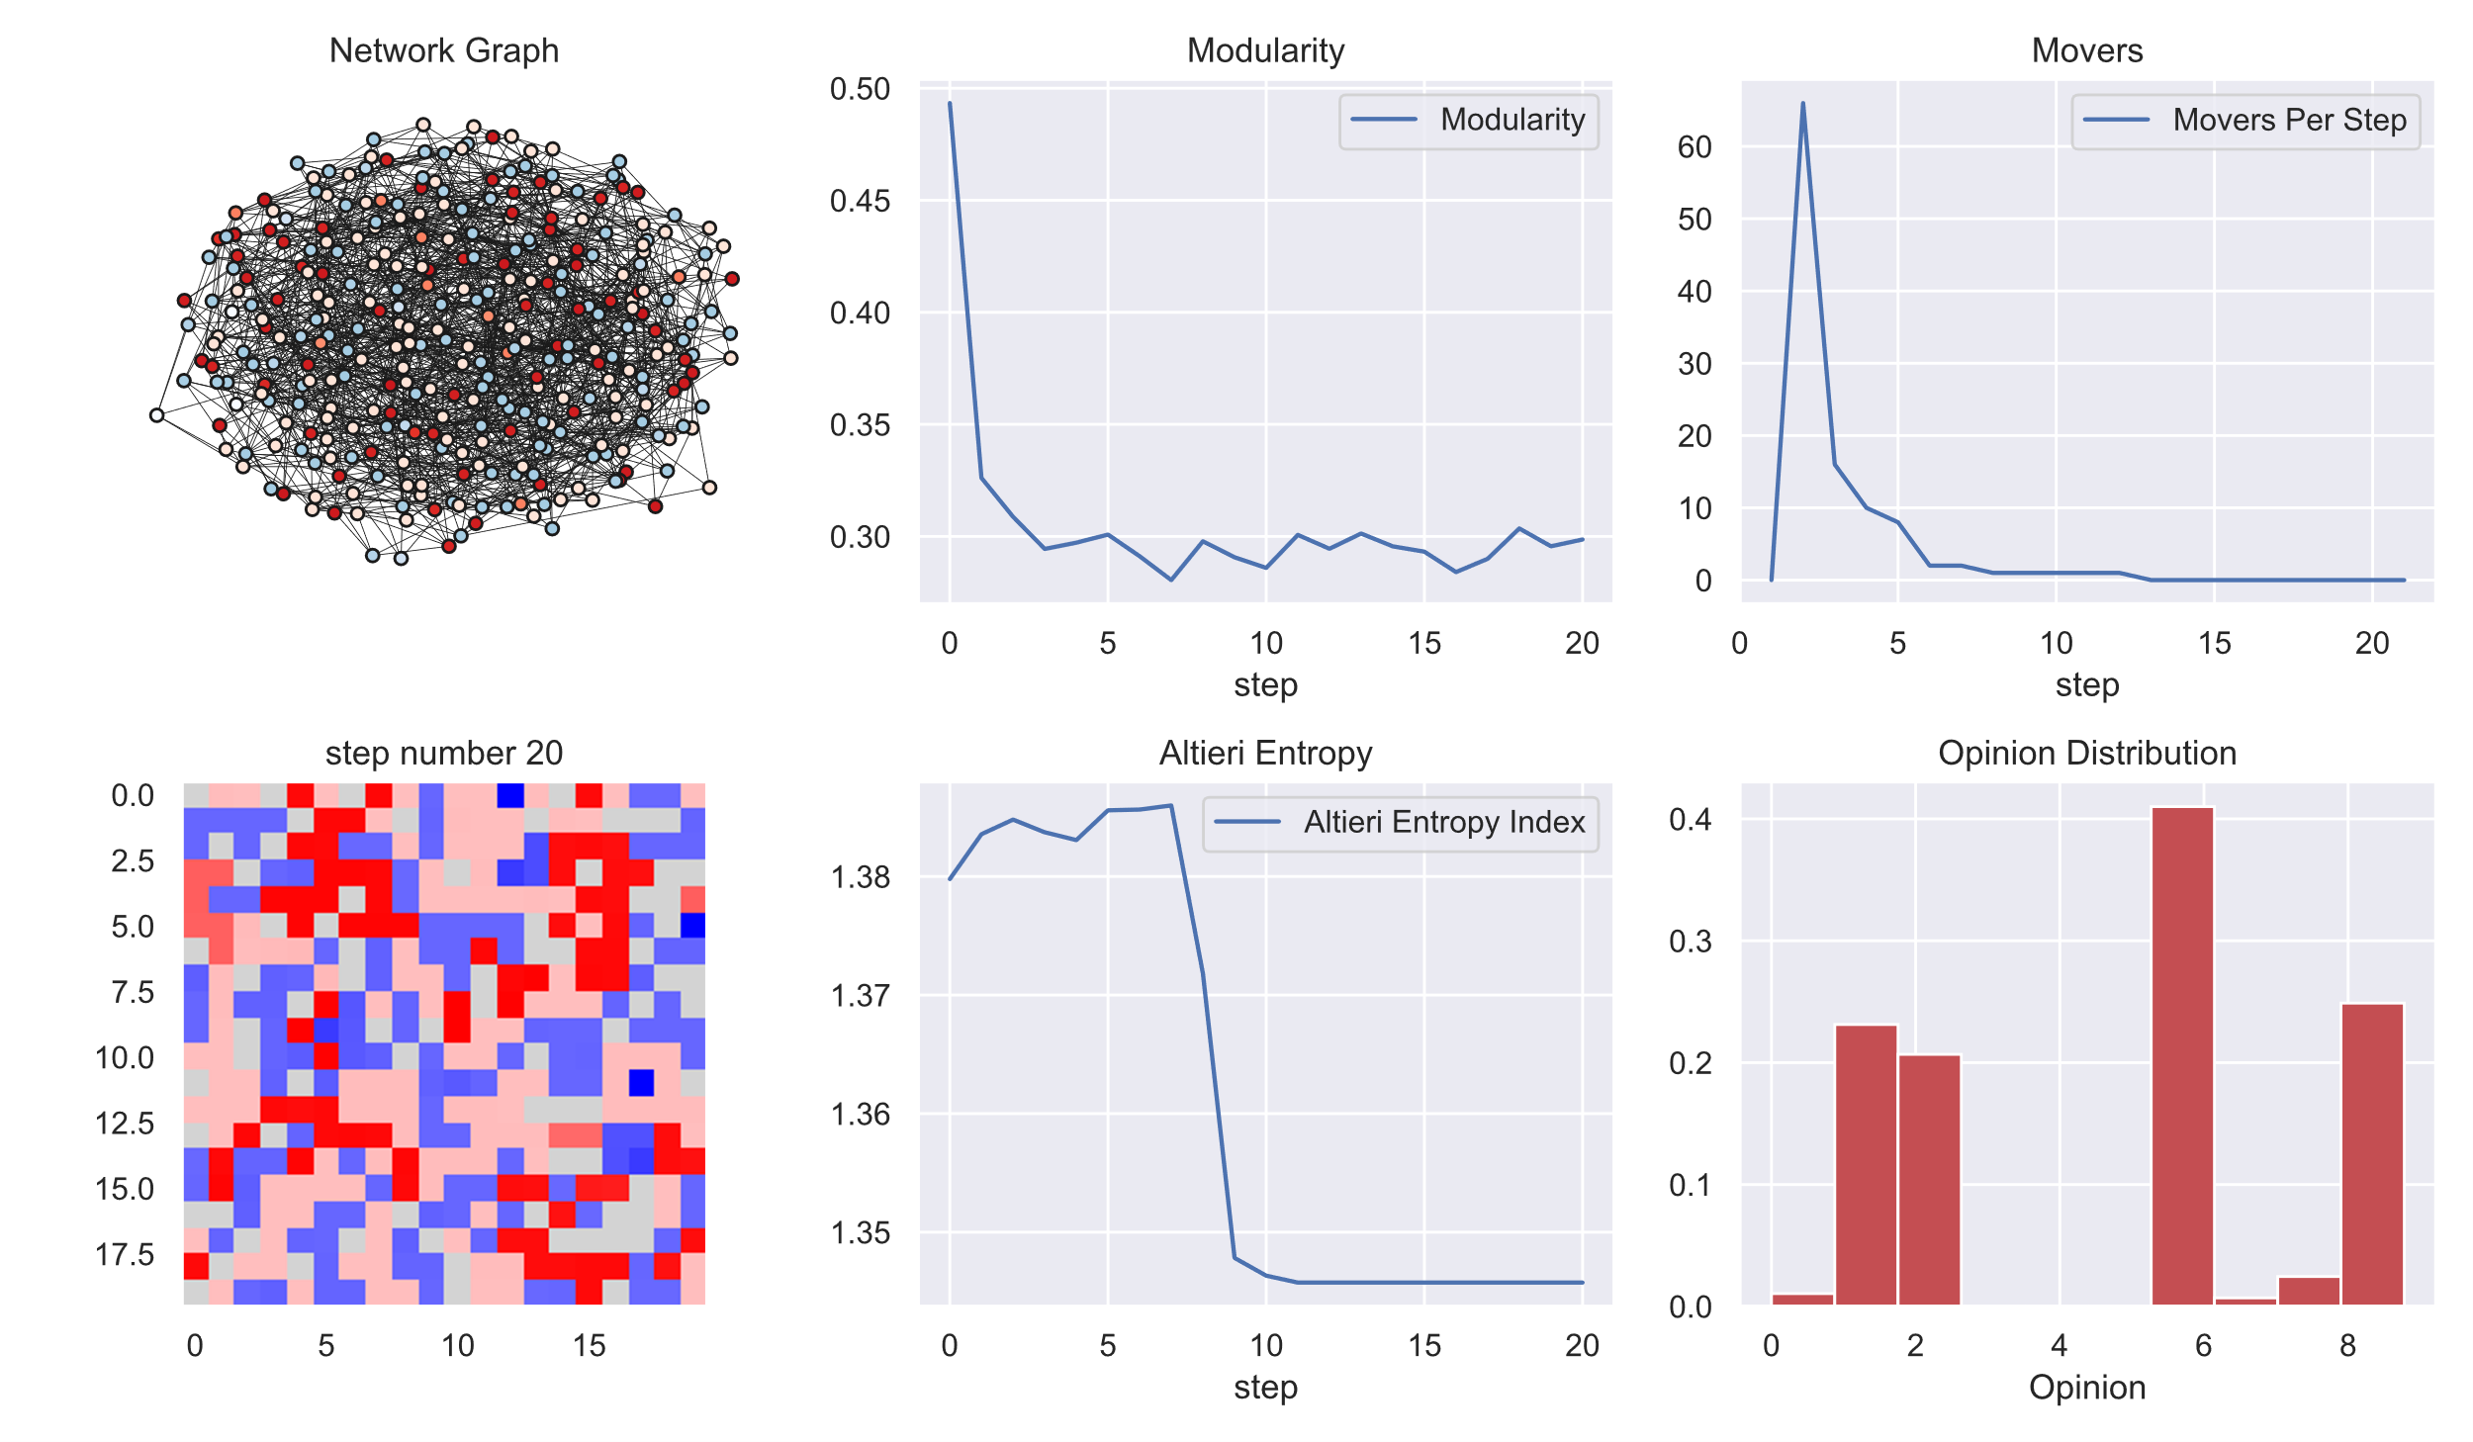
Experiment: Add cross-group contact
Conformity = 0.8
Without Cross Connection
With Cross Connection

Slide 14
Conclusion
Conformity pushes opinion polarization in an intolerant society.
In a society with high conformity pressure, it (cross-group contact) can have counter-intuitive consequences due to rejection of alien opinion (Stephan &Morrison, 2009).
Presence or absence of passive ideologues doesn't bear any impact on polarization.

Slide 15
Challenges and Limitations
Limitations of the Model
Small network
Simple model
Variance and sensitivity analysis
Future Research Directions
Multi-opinionated society
More complex interactions, like preference to friends/ acquaintances
Incorporate active ideologues/ radicalizers

Slide 16

Questions?
"To break ranks and step out, to adopt overtly nonconformist behavior, was simply beyond most of the men. It was easier for them to shoot.”
― Christopher R. Browning, Ordinary Men:

